Slide 1
ITP171 IT Fundamentals aND PROJECT
COMPUTER SOFTWARE

Slide 2
Computer Software
Software, also called a program, tells the computer what tasks to perform and how to perform them
System Software
Operating system
Utility program
Application Software

Slide 3
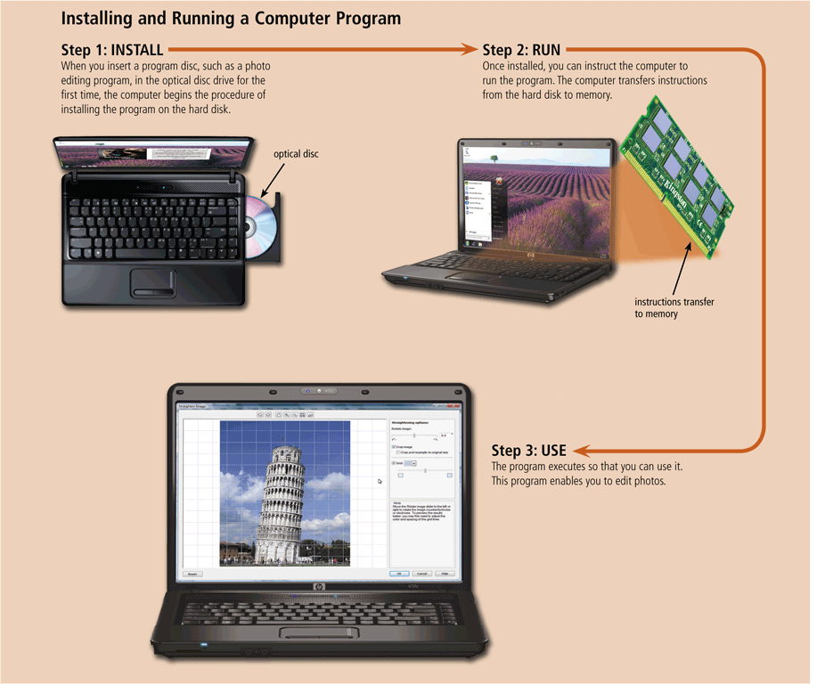
Computer Software
Installing is the process of setting up software to work with the computer, printer, and other hardware

Slide 4
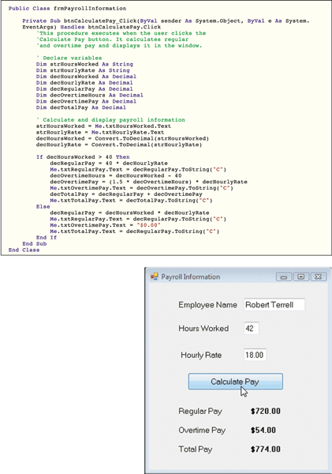
Computer Software
A programmer develops software or writes the instructions that direct the computer to process data into information

Slide 5
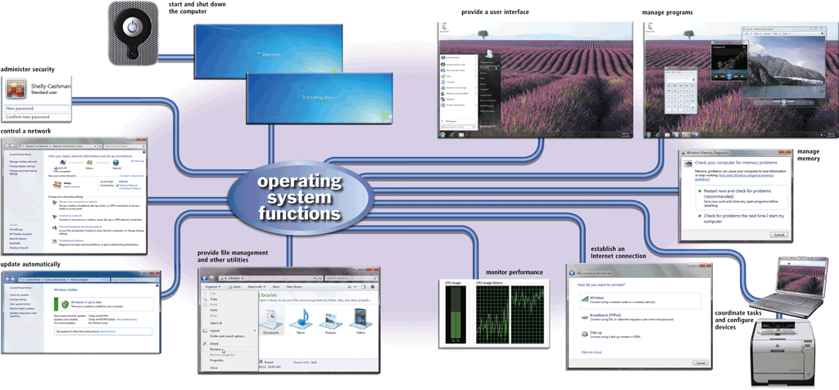
Operating Systems
An operating system (OS) is a set of programs containing instructions that work together to coordinate all the activities among computer hardware resources

Slide 6
Server Operating Systems
Windows Server 2008
UNIX
Linux
Solaris
NetWare

Slide 7
Server Operating Systems
Some operating systems are designed to work with a server on a network
A server operating system organizes and coordinates how multiple users access and share resources on a network
A network administrator uses the server operating system to:
Add and remove users, computers, and other devices
Install software and administer network security

Slide 8
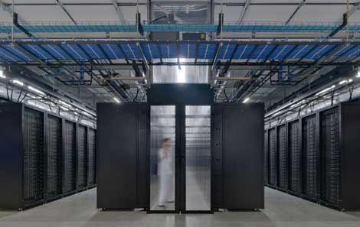
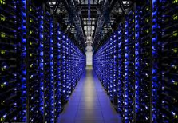
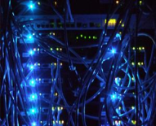
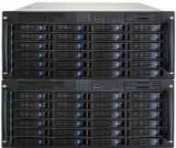
What is Infrastructure Software
Remember Amazon?

Slide 9
When A Order Arrives At Amazon
Software work together to fulfil the order
These software are infrastructure software or server software as they are not done on your device
They work on the concept of accepting a request and servicing the request or client/server model
Examples in the service industry…

Slide 10

Database Server

Slide 11
Database Server
Data is the smallest element in IT
IT = Information Technology
Information is data made meaningful
With no data, you cannot use IT to make any decision or information
More data, more informed decisions but data overload is a problem

Slide 12
Database Vendors
Oracle Database Server
IBM DB2
Microsoft SQL Server

Slide 13
Email Server
Email is the “blood flow” for most companies using IT
Everything can fail except email
Email is a critical infrastructure software for all companies
Email key technologies of receiving and sending is the foundation for social media like Facebook, Twitter
SMTP: Simple Mail Transfer Protocol

Slide 14

How Email Exactly Works

Slide 15
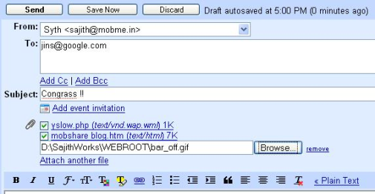
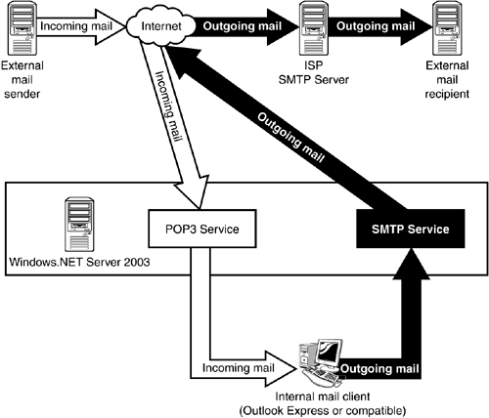
Email Server
Unstructured data

Slide 16
Email Servers
Microsoft Exchange
IBM Lotus Domino
Sendmail
Zimbra

Slide 17
Web Server/Application Server
A Web Server accepts requests in HTML and processes them
Then it returns the HTML code to your device so that you are presented with the information

Slide 18
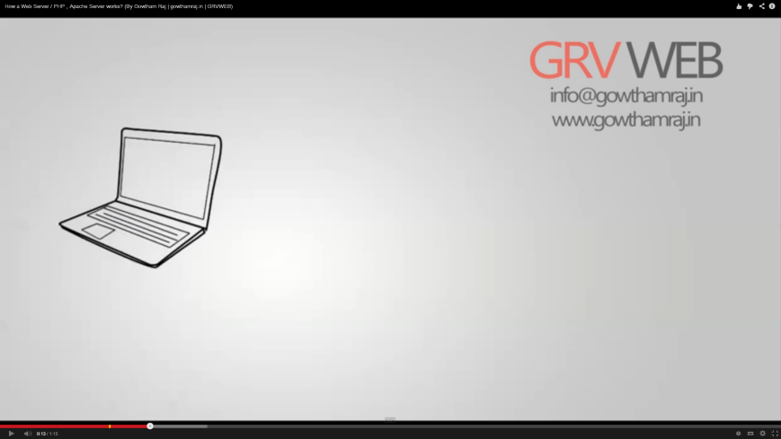
How Web Server Works

Slide 19
Web Servers
Microsoft IIS
Google etc..
http://news.netcraft.com/archives/2012/07/03/july-2012-web-server-survey.html

Slide 20
Putting Everything Together – Engineered Systems
Used everyday
Used by corporates inspired by a fruit

Slide 21
Conclusions
We have learned the other pillar of IT which is software
Introduction to some of the software that is are termed as infrastructure software
Infrastructure software are usually placed on machines called servers

Slide 22
Fun Quiz
Play Kahoot Game:
https://kahoot.it/
Enter NickName: 1_xxx
( for group 1 students)

